Slide 1


E-COMMERCE ONLINE DATA ANALYSIS REPORT OF DASHBOARD
PRESENTATION BY :
PANKAJ KUMAR
AMAN MISHRA
VARUN PRAJAPATI
GEETANSHU
ABHINAV MISHRA
SNEHIL AGARWAL

Slide 2
AGENDA
1.Introduction and Objectives
2. SQL Operation and Queries
3.Establishing SQL database connection
4.Inroduction to data analysis in depth
5.Jupyter Notebook Exploration
6.Power BI development
7. Key Visualization and Interpretation
8.Actionable Insights and Recommendation
9.Conclusion an Next Steps

Slide 3
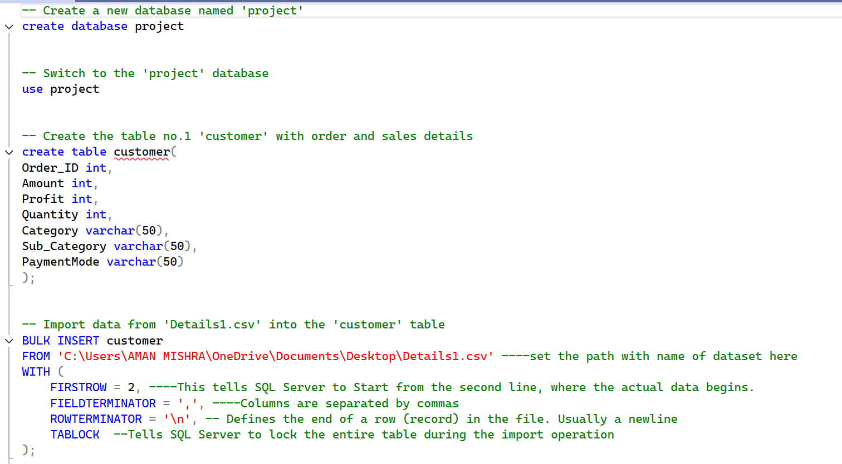

Slide 4
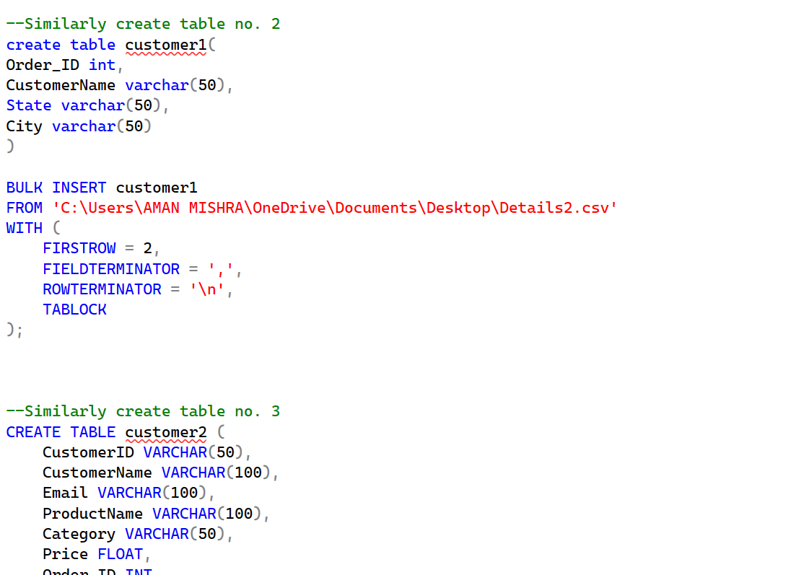

Slide 5
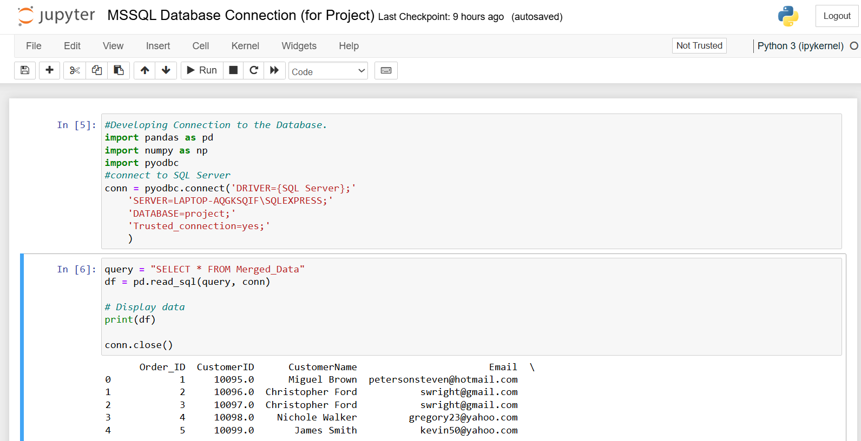

Slide 6
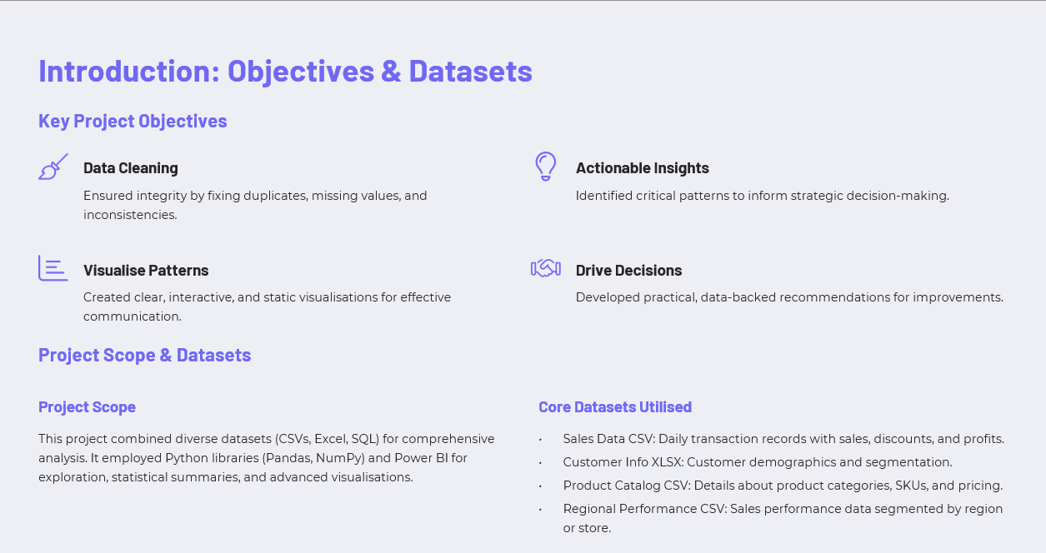

Slide 7
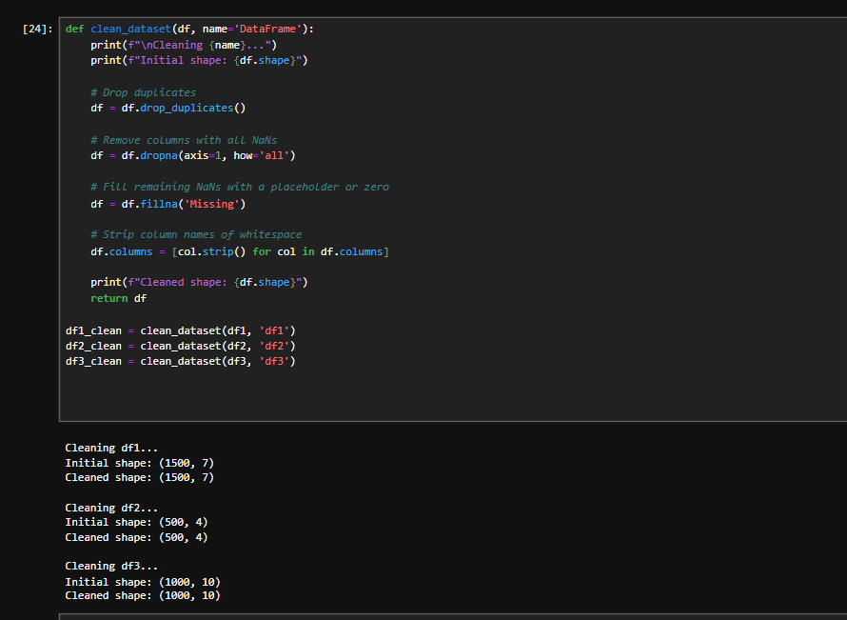

Slide 8
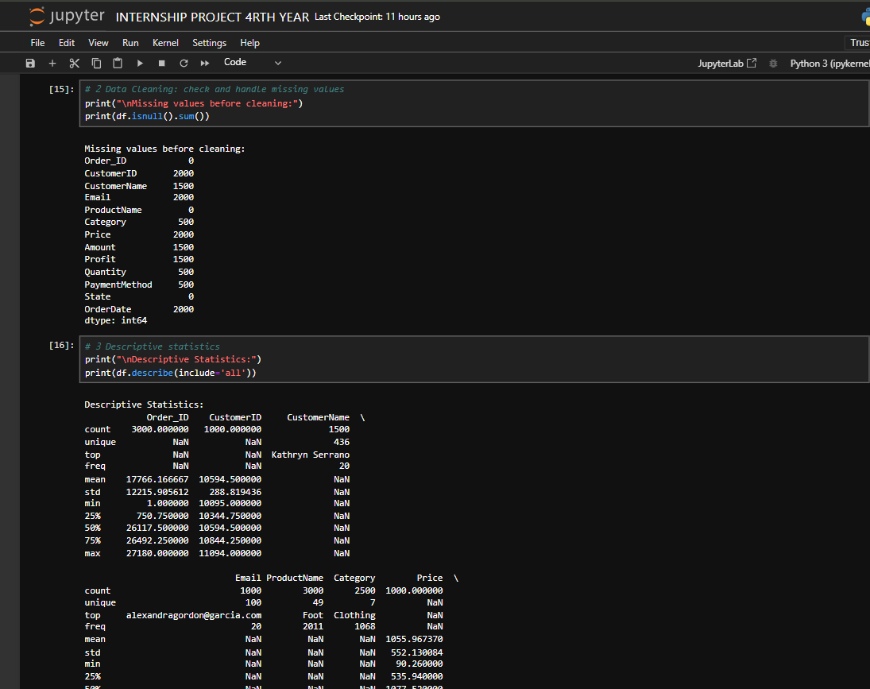

Slide 9
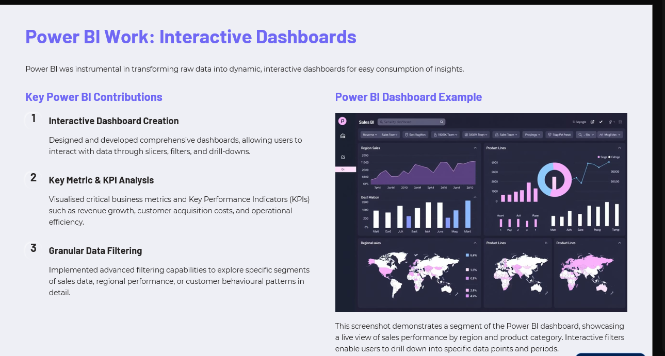

Slide 10
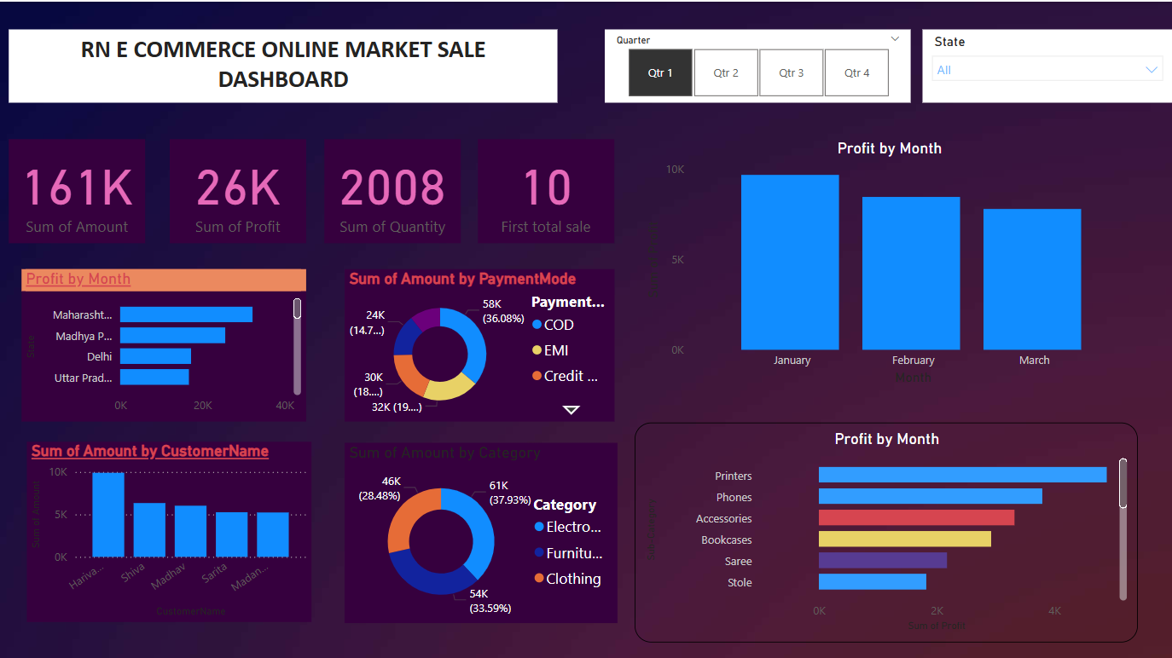

Slide 11
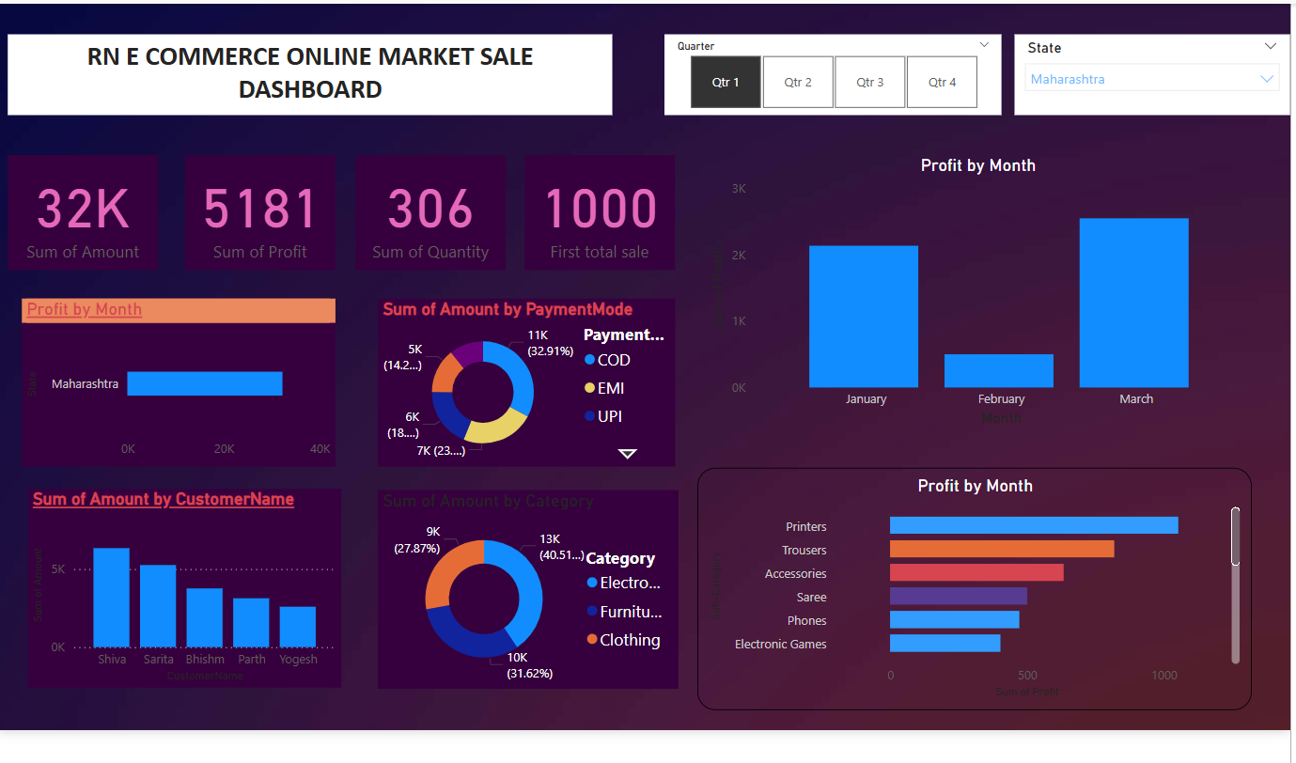

Slide 12
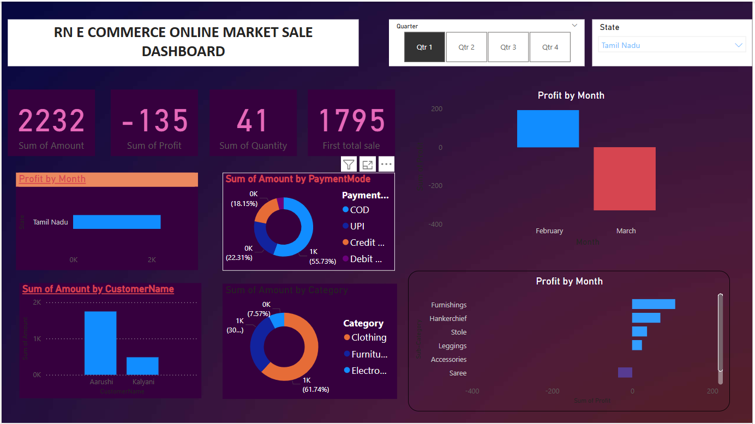

Slide 13
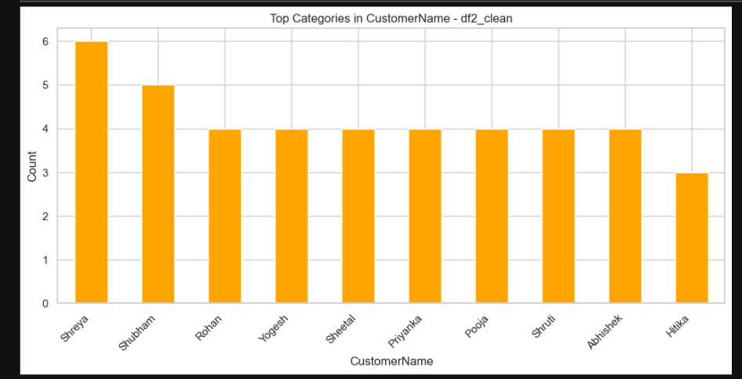
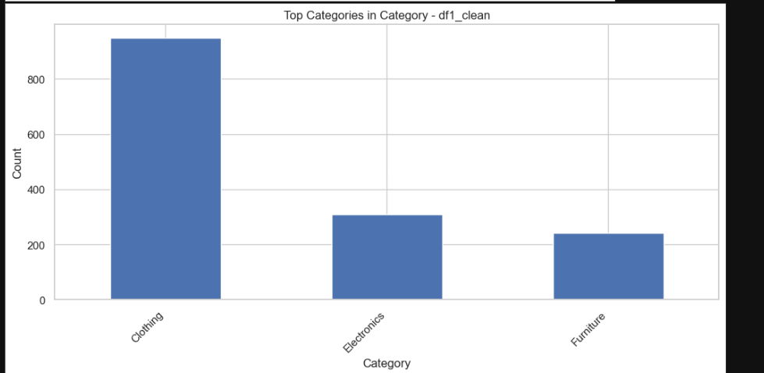
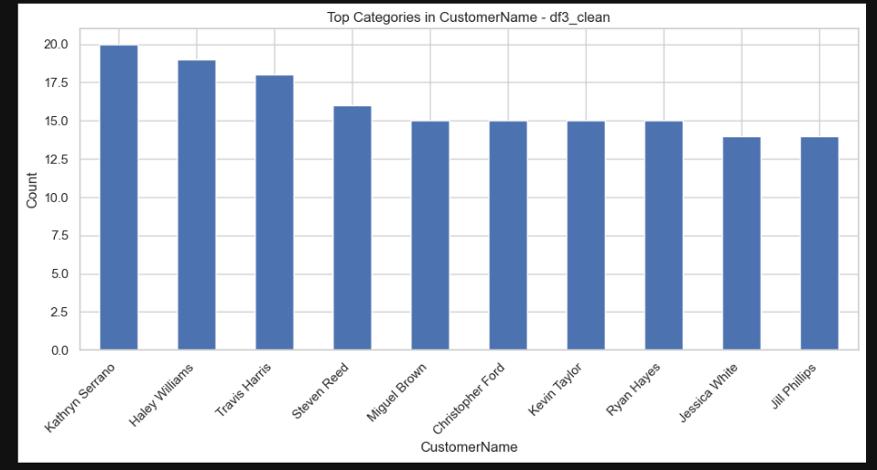
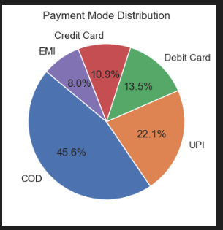

Slide 14
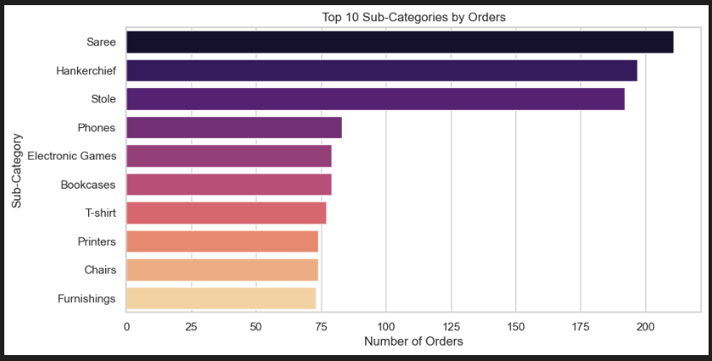
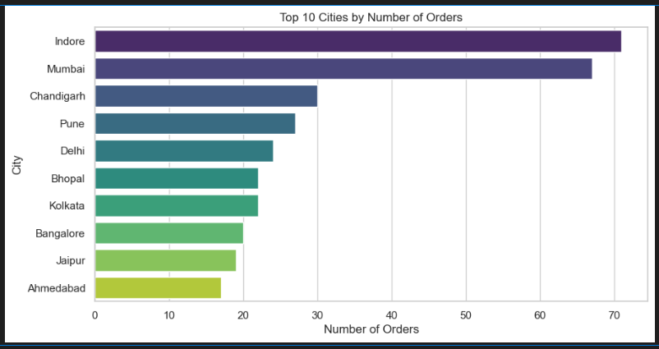
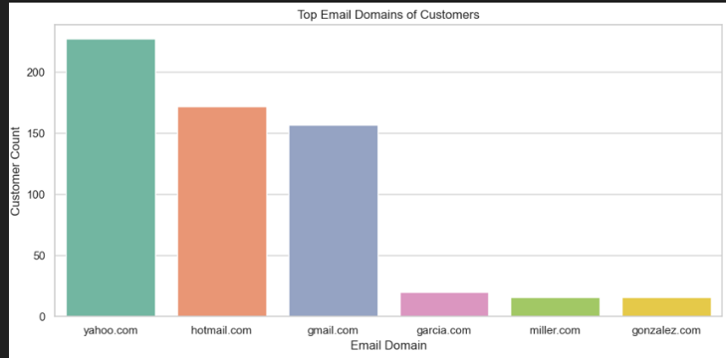
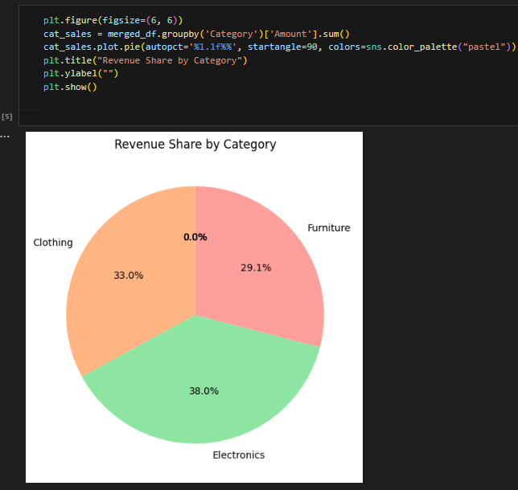

Slide 15
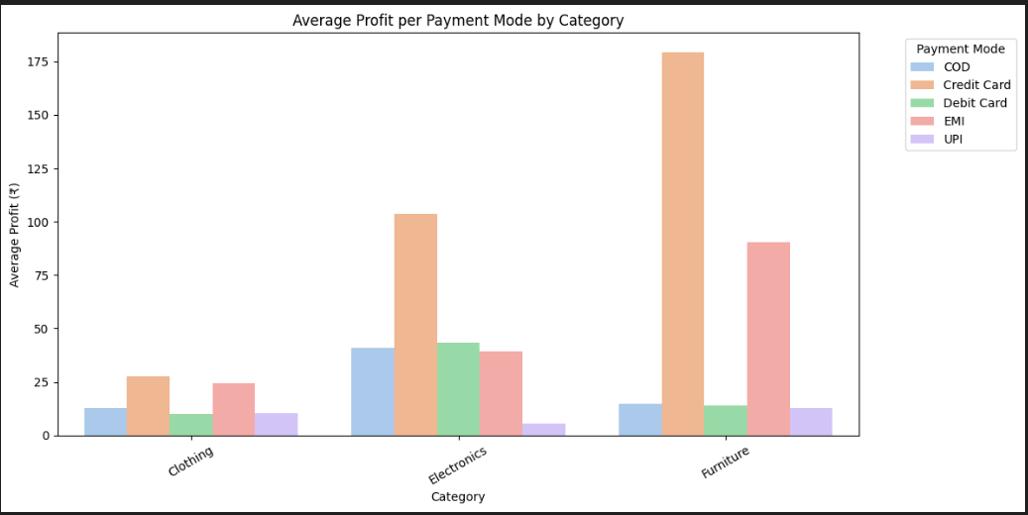
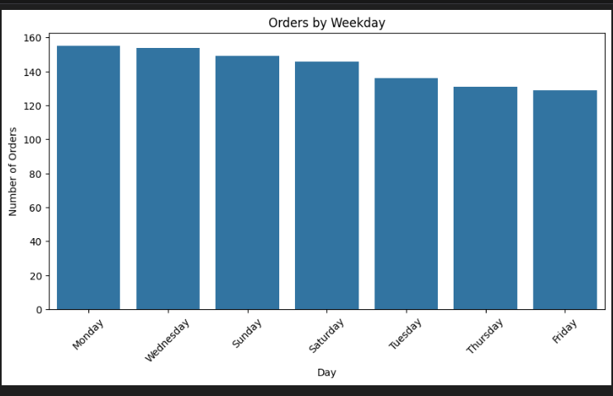
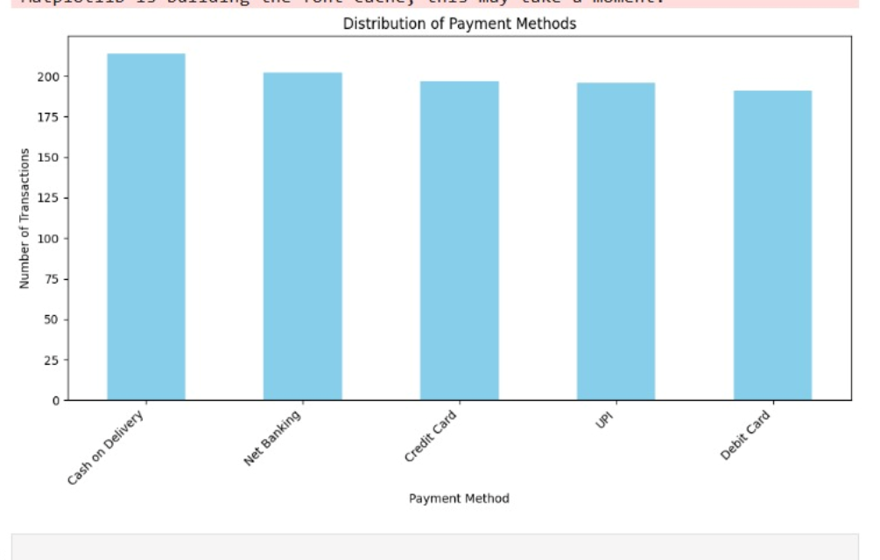
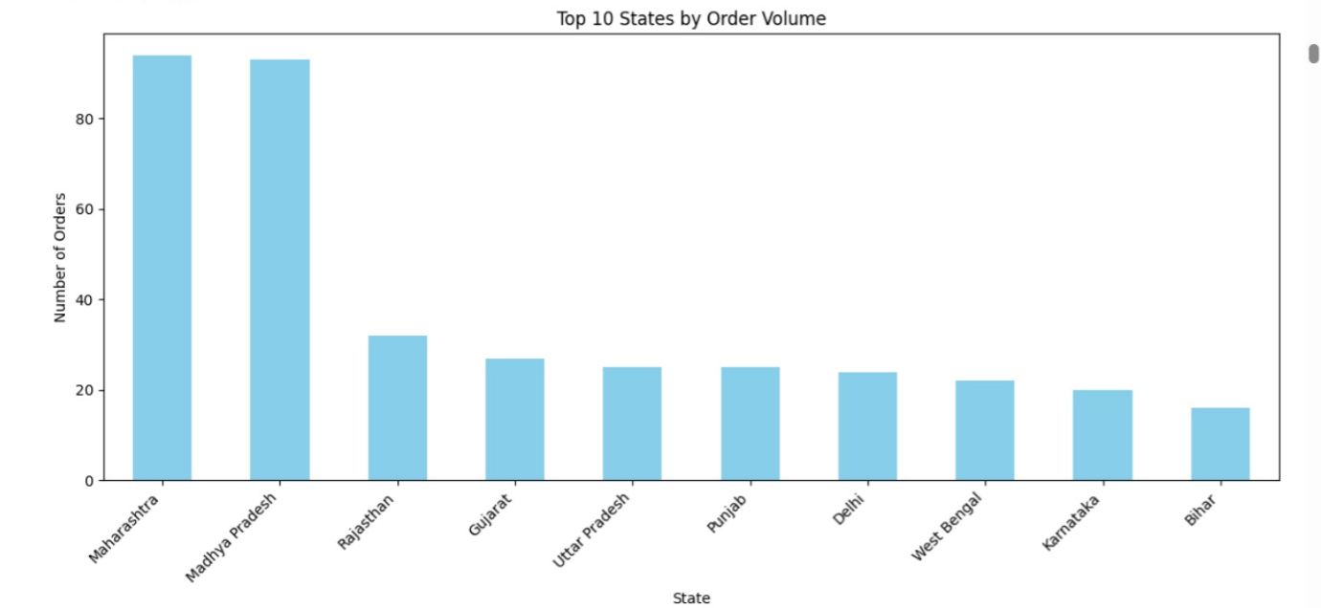

Slide 16
🔑 Key Insights
✅ Category Imbalance
Significant imbalance observed among categories, which may bias model predictions or skew aggregated metrics.
✅ Correlation & Redundancy
Correlation analysis revealed some variables with high interdependence, suggesting potential redundancy that could be optimized through feature selection or dimensionality reduction.
✅ Outliers in Numeric Features
Distribution plots highlighted outliers significantly impacting means and standard deviations; these should be handled (e.g., with winsorization or robust statistics) to avoid misleading insights.
✅ Seasonal & Cyclical Patterns
Time-based data exhibited patterns suggesting seasonality or periodic trends, offering opportunities for forecasting and strategic planning.

Slide 17
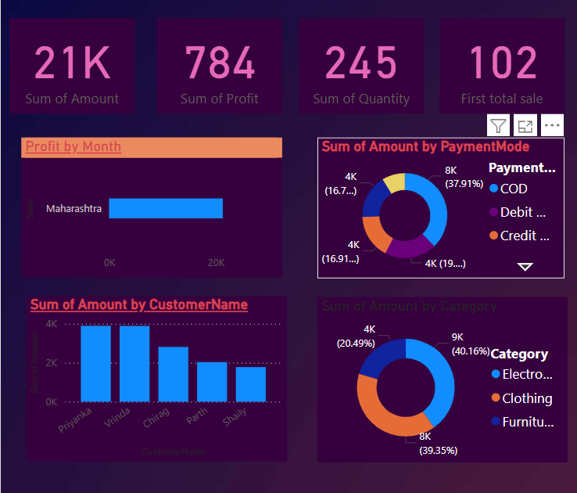

Slide 18
RECOMMENDATION FOR SALES
Prioritize Top Categories
Allocate marketing and sales efforts towards categories with the highest engagement or revenue potential to maximize ROI.
Address Underrepresented Areas
Investigate and mitigate data gaps or low-representation categories to improve overall data quality and coverage.
Implement Interactive Dashboards
Set up dynamic dashboards to continuously monitor key performance indicators, enabling timely decision-making and actionable insights.
Plan for Data Updates
Establish a routine process for data refresh and ongoing analysis to keep insights current and maintain strategic relevance.

Slide 19
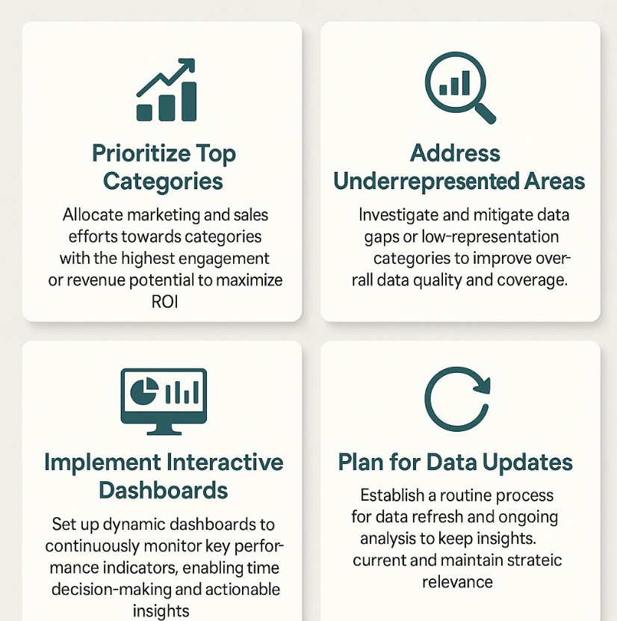

Slide 20
THANK YOU

